Slide 1
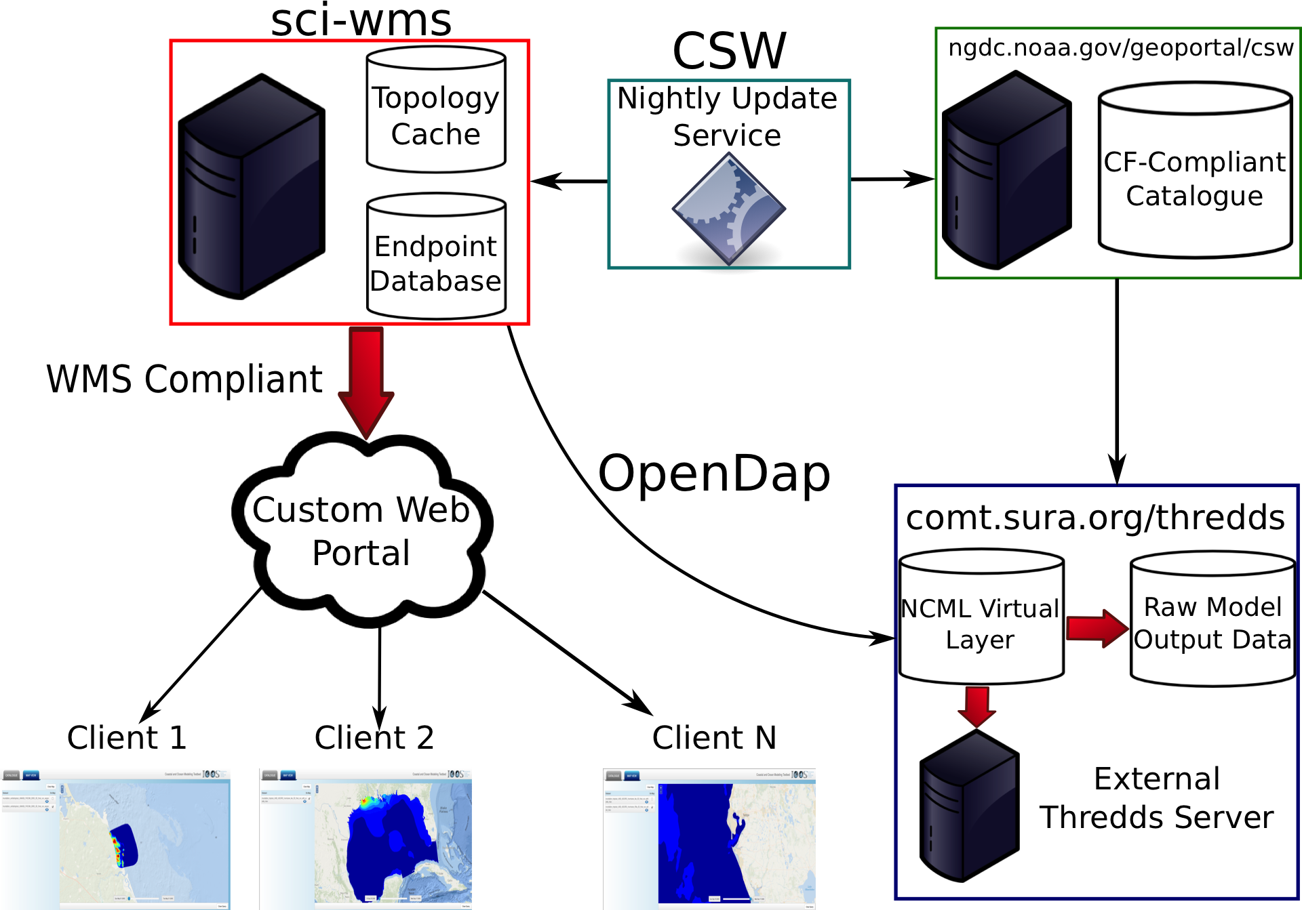
SCI-WMS: Python Web Mapping Service for Visualizing Geospatial Data
Brandon A. Mayer, Brian McKenna, Dave A. Foster, Kelly Knee
Web Mapping Service (WMS)
Deliver rasterized visualizations in response to http requests for views of geo-registered data
IOOS COMT-Testbed
Project to accelerate the turn around from research to production quality systems
SCI-WMS deployed within the IOOS COMT framework for qualitative model forecasting assessment, algorithmic/parameter selection
Supports any CF-Compliant dataset
ADCIRC, SELFE, SLOSH, FVCOM, WW3
Currently querying datasets from NGDC catalog for data hosted at multiple institutions
USF, UND, MDL, UMASS, VIMS, DAL,…
http://testbedwww.sura.org/explorer/

Slide 2
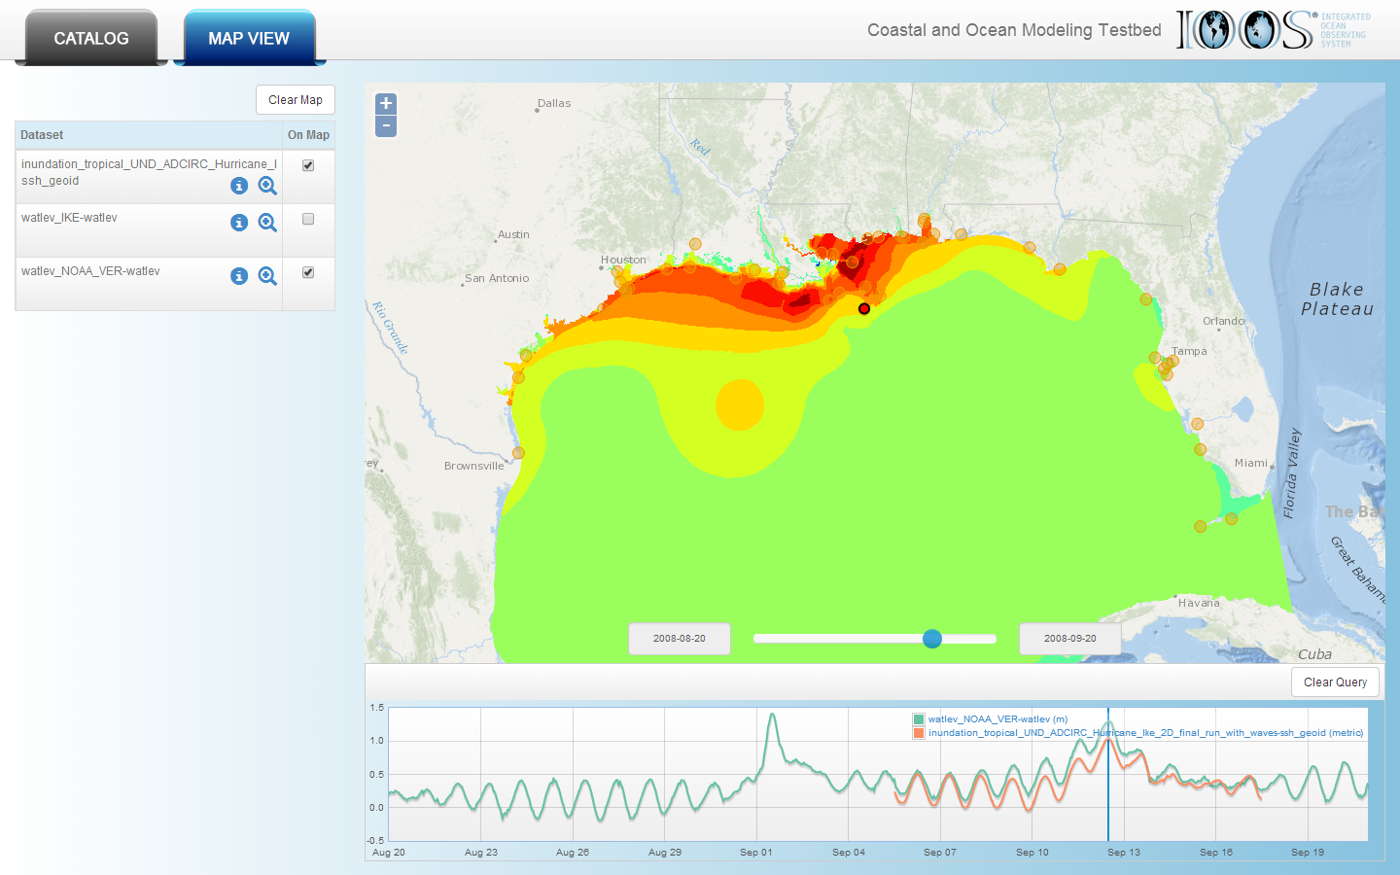
Don’t replicate and host data
Store a local copy of topologies
Use spatial oriented data structures to compute subset of data to downloaded from remote servers per request
ADCIRC – UGRID
Hurricane Ike
Verified water levels from NOAA (green) station plotted against model time series (orange)

